Slide 1
COMP 2230
Week 3 - Friday

Slide 2
Last time
Rational numbers
Divisibility

Slide 3
Questions?

Slide 4
Assignment 1

Slide 5
Logical warmup
Two women are sitting in a street cafe, talking about their children.
One says she has three daughters. The product of their ages is 36, and the sum of their ages is the number of the house across the street.
The second woman replies that this information is not enough to figure out the age of each child.
The first agrees and adds that her oldest daughter has beautiful blue eyes.
Then the second solves the puzzle.
What are the ages of the daughters?

Slide 6
Divisibility

Slide 7
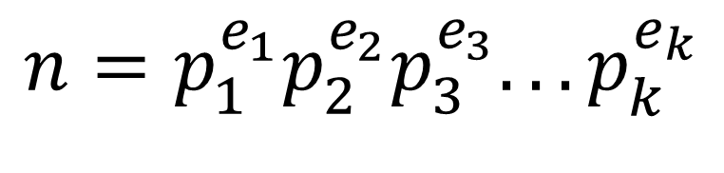
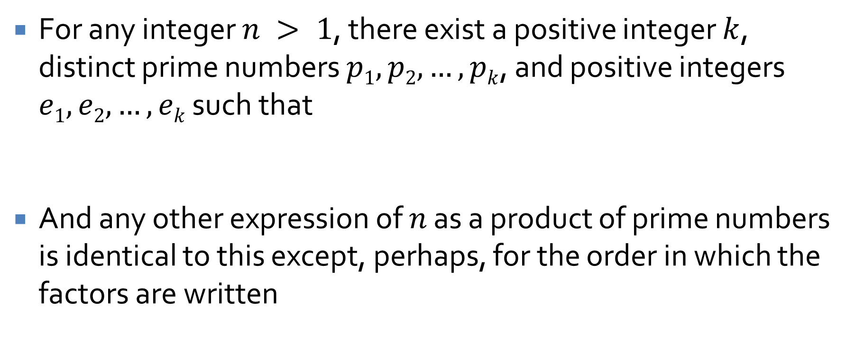
Unique factorization theorem
For any integer $n > 1$, there exist a positive integer $k$, distinct prime numbers $p1, p2, …, pk$, and positive integers $e1, e2, …, ek$ such that
And any other expression of $n$ as a product of prime numbers is identical to this except, perhaps, for the order in which the factors are written
$$n=p_{1}^{e_{1}}p_{2}^{e_{2}}p_{3}^{e_{3}}...p_{k}^{e_{k}}$$

Slide 8
Proof by Cases

Slide 9
Proof by cases
If you have a premise consisting of clauses that are ANDed together, you can split them up
Each clause can be used in your proof
What if clauses are ORed together?
You don't know for sure that they're all true
In this situation, you use a proof by cases
Assume each of the individual possibilities is true separately
If the proof works out in all possible cases, it still holds

Slide 10
Proof by cases formatting
For a direct proof using cases, follow the same format that you normally would
When you reach your cases, number them clearly
Show that you have proved the conclusion for each case
Finally, after your cases, state that, since you have shown the conclusion is true for all possible cases, the conclusion must be true in general

Slide 11
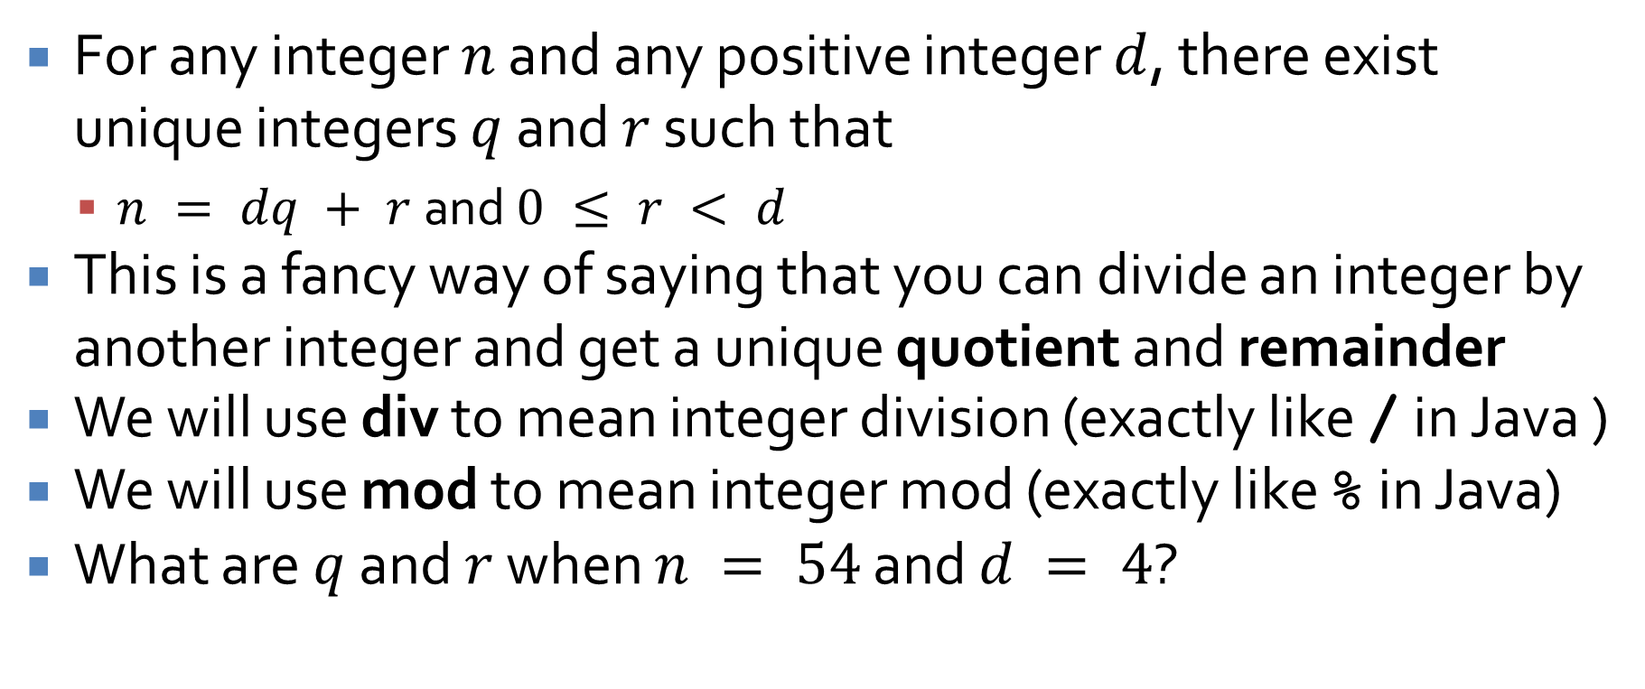
Quotient-remainder theorem
For any integer $n$ and any positive integer $d$, there exist unique integers $q$ and $r$ such that
$n = dq + r$and $0 ≤ r < d$
This is a fancy way of saying that you can divide an integer by another integer and get a unique quotient and remainder
We will use div to mean integer division (exactly like / in Java )
We will use mod to mean integer mod (exactly like % in Java)
What are $q$ and $r$ when $n = 54$ and $d = 4$?

Slide 12
Consecutive integers have opposite parity
Prove that, given any two consecutive integers, one is even and the other is odd
Hint: Divide into two cases:
The smaller of the two integers is even
The smaller of the two integers is odd

Slide 13

Another proof by cases
Theorem: for all integers $n$, $3n2 + n + 14$ is even
How could we prove this using cases?
Be careful with formatting

Slide 14
Indirect Proof

Slide 15
Proof by contradiction
The most common form of indirect proof is a proof by contradiction
In such a proof, you begin by assuming the negation of the conclusion
Then, you show that doing so leads to a logical impossibility
Thus, the assumption must be false and the conclusion true

Slide 16
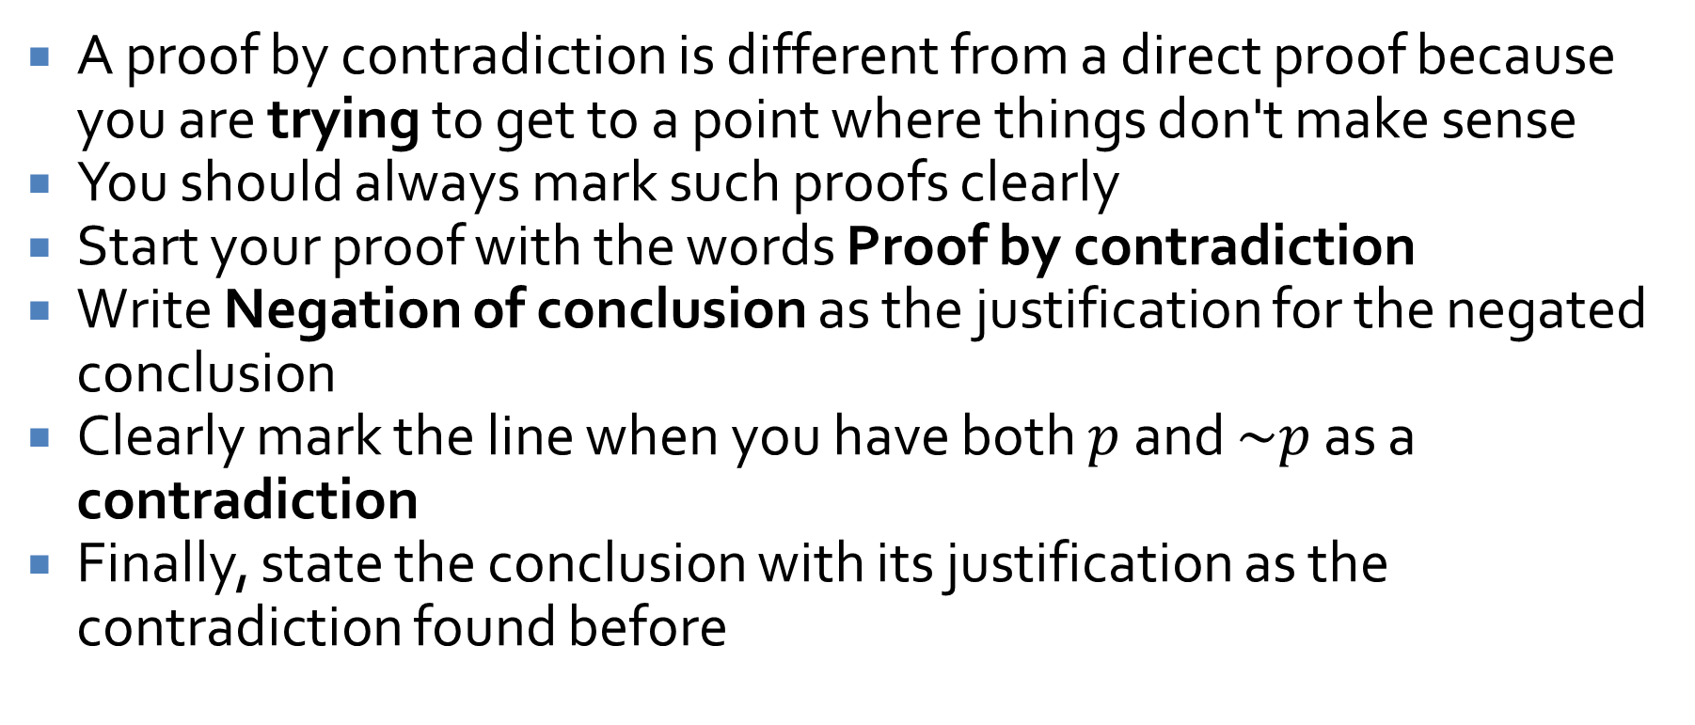
Contradiction formatting
A proof by contradiction is different from a direct proof because you are trying to get to a point where things don't make sense
You should always mark such proofs clearly
Start your proof with the words Proof by contradiction
Write Negation of conclusion as the justification for the negated conclusion
Clearly mark the line when you have both $p$ and $\sim p$ as a contradiction
Finally, state the conclusion with its justification as the contradiction found before

Slide 17
Example
Theorem: There is no largest integer.
Proof by contradiction: Assume that there is a largest integer.

Slide 18
Another example
Theorem: There is no integer that is both even and odd.
Proof by contradiction: Assume that there is an integer that is both even and odd

Slide 19

Another example
Theorem: $x, y  ℤ+, x2 – y2  1$
Proof by contradiction: Assume there is such a pair of integers

Slide 20
Two Classic Results

Slide 21
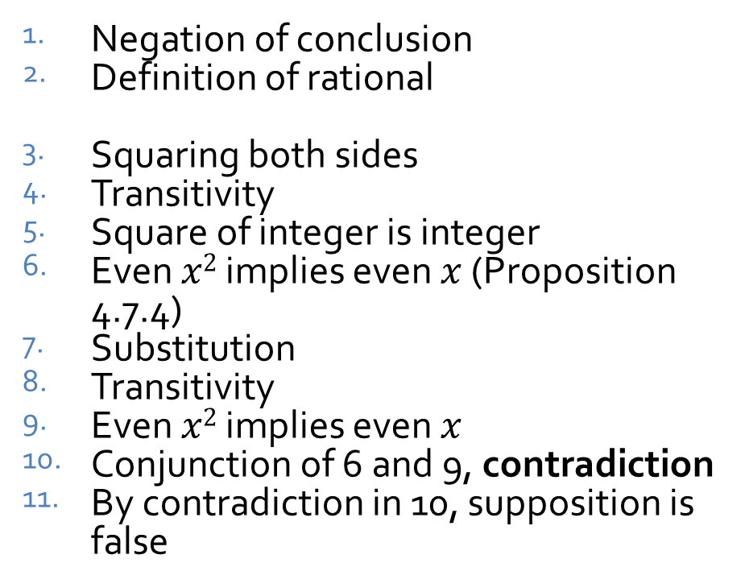
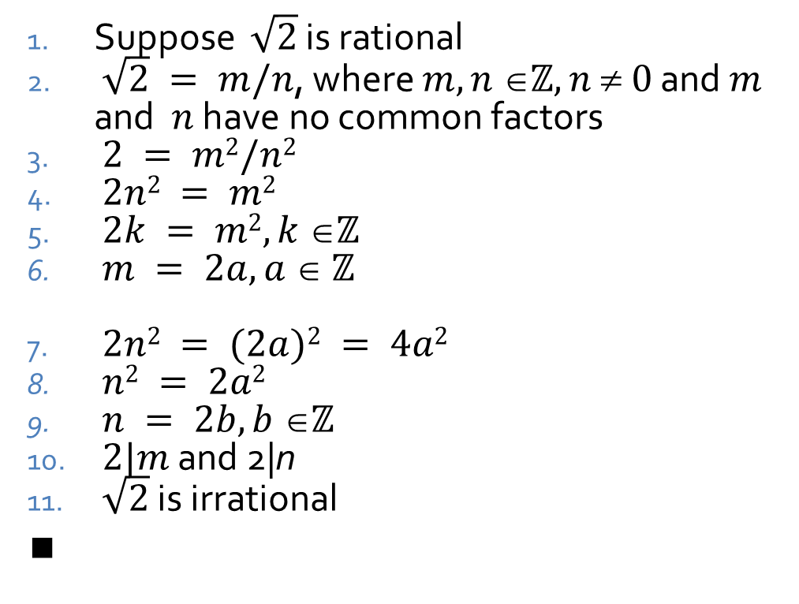
Square root of 2 is irrational
Theorem: $\sqrt{2}$ is irrational
Proof by contradiction:
Suppose $\sqrt{2}$ is rational
$\sqrt{2} = m/n$, where $m,n ℤ, n  0$ and $m$ and $n$ have no common factors
$2 = m2/n2$
$2n2 = m2$
$2k = m2, k ℤ$
$m = 2a, a  ℤ$
$2n2 = (2a)2 = 4a2$
$n2 = 2a2$
$n = 2b, b ℤ$
$2|m$ and 2|n
$\sqrt{2}$ is irrational
$$∎$$
Negation of conclusion
Definition of rational
Squaring both sides
Transitivity
Square of integer is integer
Even $x2$ implies even $x$ (Proposition 4.7.4)
Substitution
Transitivity
Even $x2$ implies even $x$
Conjunction of 6 and 9, contradiction
By contradiction in 10, supposition is false

Slide 22
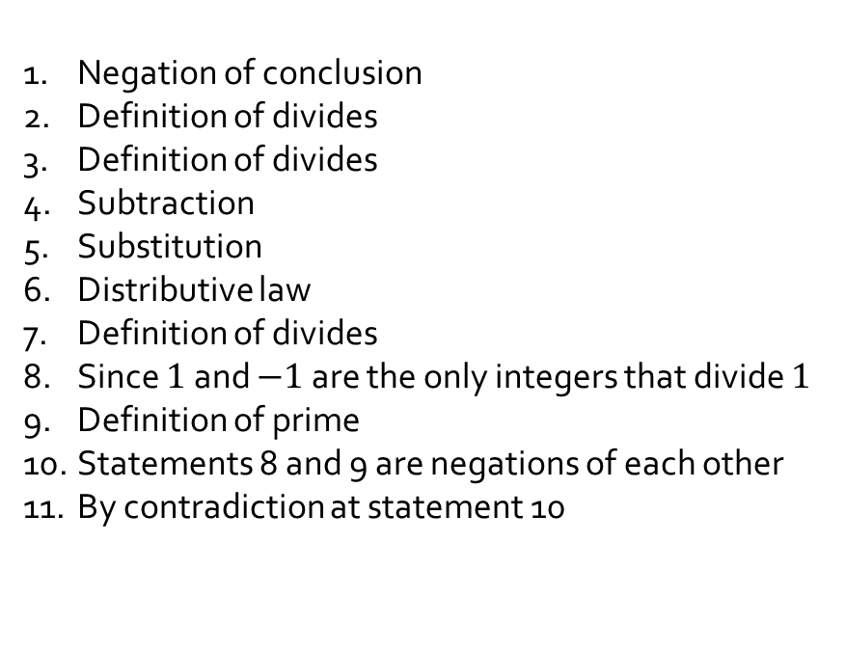
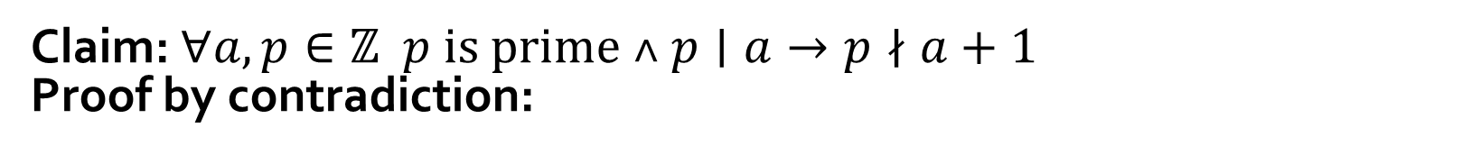
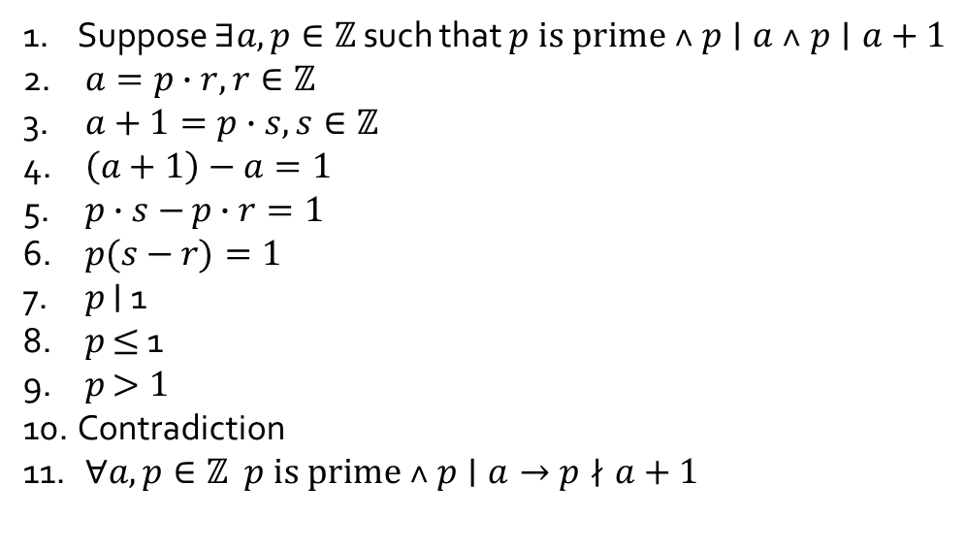

Proposition 4.7.3
Claim: $∀a,p∈ℤ p is prime ˄ p∣a→p∤a+1$
Proof by contradiction:
Negation of conclusion
Definition of divides
Definition of divides
Subtraction
Substitution
Distributive law
Definition of divides
Since $1$ and $−1$ are the only integers that divide $1$
Definition of prime
Statements 8 and 9 are negations of each other
By contradiction at statement 10
Suppose $∃a,p∈ℤ$ such that $p is prime ˄ p∣a ˄ p∣a+1$
$a=p∙r, r∈ℤ$
$a+1=p∙s, s∈ℤ$
$\left(a+1\right)−a=1$
$p∙s−$ $p∙r=1$
$p(s−$ $r)=1$
$p$ $∣$ 1
$p$ $≤$ 1
$p$ $>1$
Contradiction
$∀a,p∈ℤ p is prime ˄ p∣a→p∤a+1$
$$∎$$

Slide 23
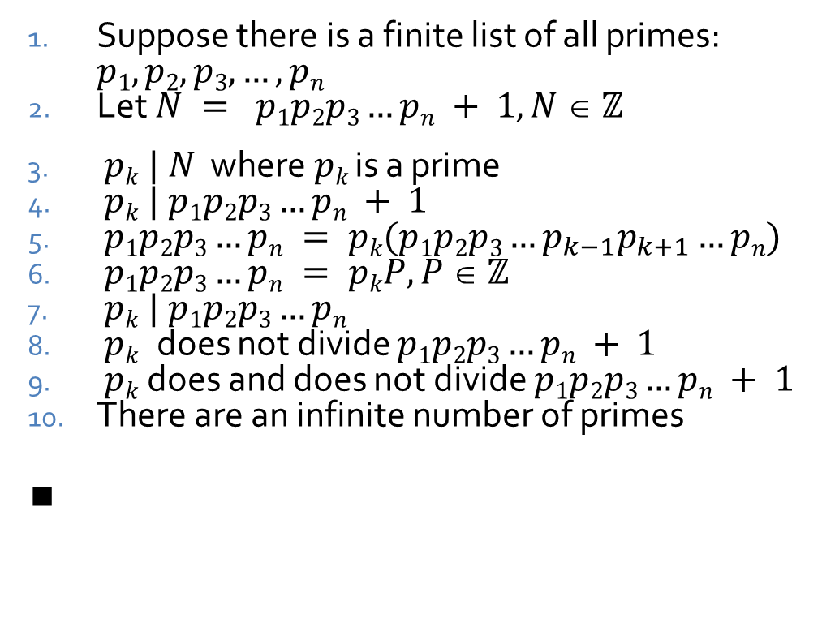
Infinitude of primes
Theorem: There are an infinite number of primes
Proof by contradiction:
Suppose there is a finite list of all primes: $p1, p2, p3, …, pn$
Let $N = p1p2p3…pn + 1, N  ℤ$
$pk | N$ where $pk$ is a prime
$pk | p1p2p3…pn + 1$
$p1p2p3…pn = pk(p1p2p3…p_{k−1}p_{k+1}…pn)$
$p1p2p3…pn = pkP, P  ℤ$
$pk | p1p2p3…pn$
$pk$ does not divide $p1p2p3…pn + 1$
$pk$ does and does not divide $p1p2p3…pn + 1$
There are an infinite number of primes
$$∎$$
Negation of conclusion
Product and sum of integers is an integer
Theorem 4.4.4
Substitution
Commutativity
Product of integers is integer
Definition of divides
Proposition from last slide
Conjunction of 4 and 8, contradiction
By contradiction in 9, supposition is false

Slide 24
A few notes about indirect proof
Don't combine direct proofs and indirect proofs
You're either looking for a contradiction or not
Proving the contrapositive directly is equivalent to a proof by contradiction

Slide 25
Upcoming

Slide 26
Next time…
Exam 1!

Slide 27
Reminders
Finish Assignment 1
Due tonight by midnight!
Review for Exam 1
Next Monday!

